Slide 1
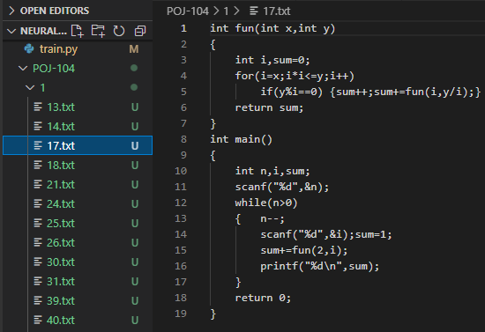
DATASET - POJ-104
Contains text files of C code
Consists of 104 folders
Each folder contains 500 files that have the same semantic value (they solve the same problem) but different syntax.
Total 52,000 C code files

Slide 2
METRIC - MAP@R
MAP - Mean of Average Precision
R - number of most similar samples retrieved for a given query.
For the POJ-104 dataset, for a code, R is set to the number of other codes in the same folder (= 499)
Task - Use the POJ-104 dataset to get zero-shot results from an untrained transformer and compute the MAP@R score. Only used the transformer encodings to get the similarity between the codes.

Slide 3
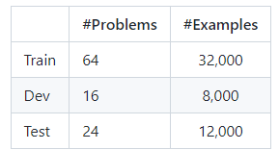
Data Preprocessing
Created three .jsonl files i.e train, valid and test.
Each line in the file represents one code.
The json file contains 3 key value pairs :
label - the folder number of the problem the source code solves.
index - the index of the example. (one indexing is done across all files)
code - the source code

Slide 4
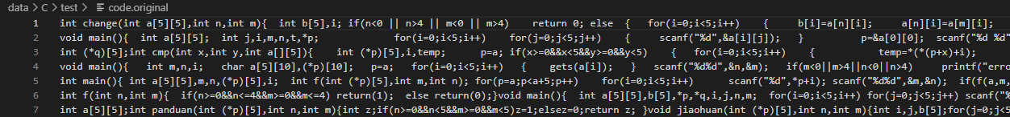
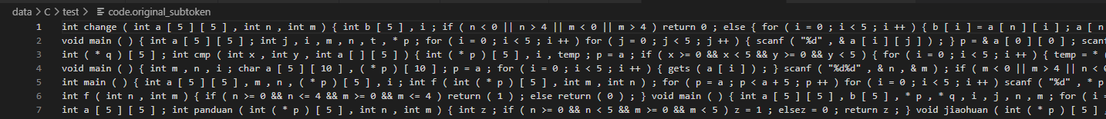
2) Extracted the source codes from the test file
3) Used pycparser for lexical analysis of C code and obtained tokens
Extracted source codes
Tokenized using lexical analyzer

Slide 5
Computing MAP@R
Obtained the encodings of these code files using simple transformer from the NeuralCodeSum repo (the transformer file here is same as the one in sit3 repo), by shutting down the decoders.
Encodings are a vector of size 512. So if we take N samples (source code) we get a N x 512 size matrix of encodings.
We measure similarity between these encodings using cosine similarity. So, we multiply the above matrix with its transpose to get a N x N matrix wherein the i,j th entry corresponds to the similarity between the i th and j th source codes.
We can then sort this matrix for each row to obtain the highest similarity source codes and select the first R samples for MAP@R. (R = 499)

Slide 6
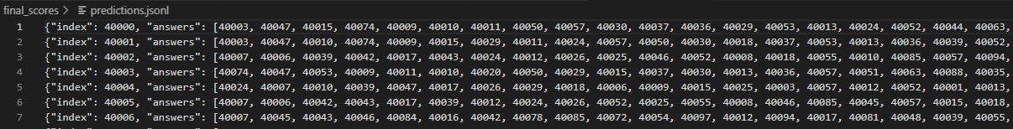
After sorting the matrix, used the indices to create a prediction file :
Finally used this predictions file and the test.jsonl file to evaluate the MAP@R score.
Wasn’t able to run code on entire dataset due to lack of gpu...
This is a json file with 2 key value pairs :
index - index of the source code
answers - list of indices that correspond to the source codes sorted by the highest similarities

Slide 7
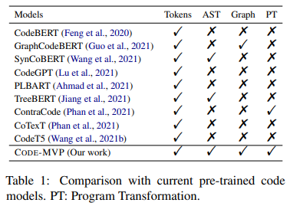
Code-MVP
Code MVP stands for Multi-View Contrastive Pre-Training
We can obtain representation of source code through its different views such as plain text, Abstract Syntax Tree, Control/Data Flow Graphs etc. This has been used in many existing approaches but each of them consider only any one of these views.
But these views contain complementary semantics of the program.
Code - MVP aims to integrate these multiple views of the code into a unified framework.

Slide 8
Program Transformation
Produce multiple variants of program that have same functional semantics.
Program transformation heuristics:
Function and Variable Renaming
Loop Exchange - exchanging of for and while loops
Dead Code Insertion - Inserting dead code snippets

Slide 9
Multi-View Contrastive Learning (MVCL)
Set of views of program - {NL, PL, AST, CFG, PT}
NL - natural language
PL - programming language
PT - program transformation (variants of program)
AST - Abstract Syntax Tree
CFG - Control Flow Graph
Code - MVP takes input in two forms :
Single-view input -
Dual-view input -

Slide 10
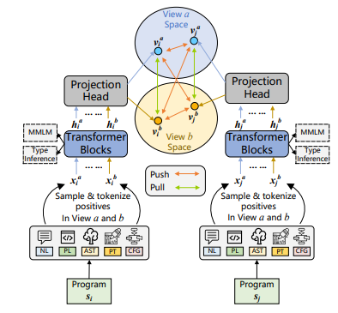
Framework Overview

Slide 11
Multi-View Positive and Negative sampling
Trained for paired (with NL) and unpaired data (without NL)
Multi-View Positive Sampling -
Single-View : For a given program, generate two of its views i.e. and . These two views form an inter-view positive pair.
Dual-View : Used an NL-conditional dual view contrastive pre-training strategy, freezing the position of NL. So here inter-view positive pair is generated between these two views : and .
Multi-View Negative Sampling - Use Single and Dual-view as in positive sampling. Leverage in mini-batch and cross mini-batch sampling strategies. Given mini batch of training, generate and . Thus for each sample there are n-1 intra-view negative samples and n-1 inter-view negative samples.

Slide 12


For a mini-batch of samples thus we have: for each program, a positive sample and 2n-2 negative samples.
Similarity of a pair of samples is defined as the dot product of their representations.
Loss function for a positive pair is :
Overall Multi-View Contrastive Learning Loss :
Loss function for a given pair will be calculated twice (once more with order switched). This is because the dot product with negative samples will be different.

Slide 13

Fine-Grained Type Inference (FGTI)
This is the second pre-training task. Used to capture the fine-grained type information of variables.
First, parse all the source codes into ASTs. Traverse the AST and use the type checker to obtain fine-grained identifier types.
FGTI Loss function is defined as :
Z denotes the set of all tokens that need to inference types
T represents the set of all types contained in the pre-training corpus
Yij denotes the label of token i in type j
Pij denotes the predicted probability of token i in type j

Slide 14

Multi-View Masked Language Modelling (MMLM)
The third and last pre-training objective.
Given data point x, randomly select 15% of tokens in x and replace them with a special token <MASK>.
The MMLM objective aims to predict the original tokens that were masked out.
MMLM loss function is defined as:
M denotes the set of masked tokens
V represents the vocabulary
Yij denotes the label of the masked token i in class j
Pij denotes the predicted probability of token i in class j

Slide 15

Overall Training Objective
Overall loss function is the integration of the several components :
Where contains all the trainable parameters of the model and is the coefficient of the L2 regularizer.

Slide 16
Pre-Training
Pre-Trained on Python corpus of CodeSearchNet dataset.
Code-MVP is built on top of transformer and consists of 12-layer encoder with 768 hidden sizes and 12 attention heads.
Pre-training procedure -
Conducted for 600k steps
Mini-batch of 128 sequences with 512 tokens each.
Length of unpaired data - 512
Length of paired data is also 512 : 96 (NL) + 416 (other view)
Learning rate 1e-4
Linear warmup over 30k steps and linear decay
Dropout rate = 0.1 on all layers
Initialize parameters of Code-MVP by GraphCodeBERT and use a BPE tokenizer.

Slide 17
Evaluation Tasks
Natural Language Code Retrieval - To find the most relevant code snippet from a collection of candidates, given a natural language query.
Code Similarity -
Code to Code Retrieval - To retrieve other programs that solve the same problem.
Code Clone Detection - Binary Classification problem
Code Defect Detection - To identify whether a given piece of code snippet is vulnerable or not. (also a binary classification task)

Slide 18
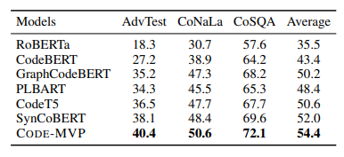
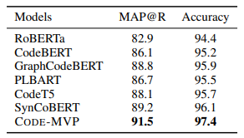
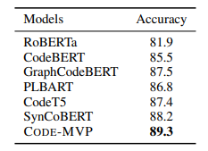
Results
Results for code-to-code retrieval and code clone detection tasks
Results for natural language code retrieval task
Results for Code Defect Detection task
Code-MVP performs better than the state-of-the-art baselines on all three downstream tasks.

Slide 19
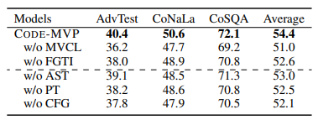
Ablation Study
Both MVCL and FGTI increase performance which confirms that the pre-training objectives are in improving program comprehension.
Exploiting different views of programs can bring performance improvements to the model as arbitrarily discarding any view of programs degrades the performance.

Slide 20
GypSum: Learning Hybrid Representations for Code
Summarization

Slide 21
Introduction
Naturalness - A measure of text quality pertaining to grammaticality and fluency. Representations learnt from token sequences preserve better the naturalness of the language and benefit text generation.
Informativeness - A measure of how much functional information is carried in a summary. Representations learnt from AST structures capture better the functional information thereby improving the informativeness of the summary.

Slide 22
The GypSum model leverages two encoders to learn hybrid latent representations from source code. The two encoders are :
c-encoder : Leverages a pre-trained model for programming language and natural language to learn the latent representations from token sequences of code snippets.
g-encoder : Leverages graph attention neural networks(GAT) to learn the latent representations from the AST base graphs. Intuition is to use the attention mechanism in GAT to capture the key functional nodes in ASTs.
Introduction of semantic edges pertaining to control flows for graph construction.
Dual-copy mechanism is proposed to facilitate summary generation.

Slide 23
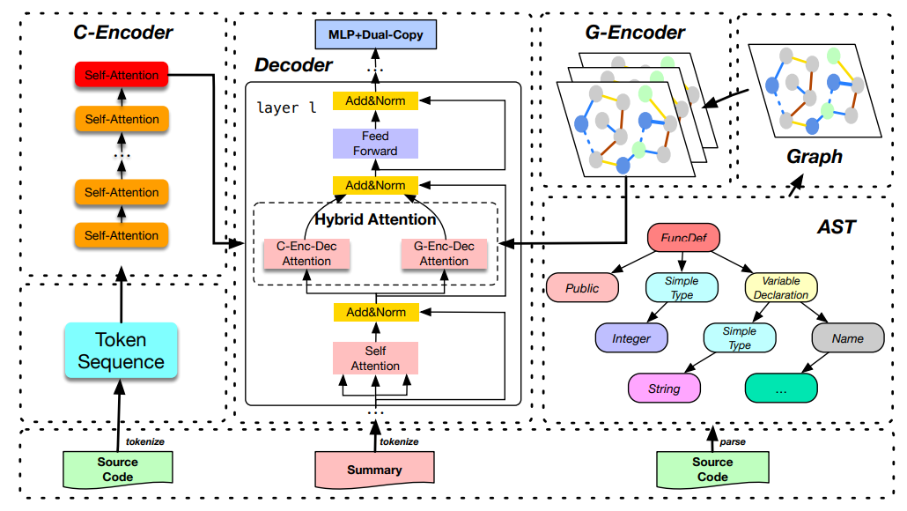

Slide 24


C-encoder
Simply convert a code snippet into a token sequence and learn the contextual representations of the tokens using NLP models.
Adopted CodeBERT to encode with the token sequences. Obtained pre-trained CodeBERT model from official repo and tuned it on dataset. Add an additional linear layer on top of its output layer and transform the embeddings so that they comply with the representations of the other encoder.
Final hidden representations are given by :
Here, . It denotes the embedding matrix generated by CodeBERT, and denotes the parameters of the linear layer. Therefore, we get the final hidden representations as .

Slide 25
G-encoder
Extending the ASTs :
In order to share vocabulary with the c-encoder, use the same tokenizer for the two encoders.
For the AST, text in some leaf nodes are further tokenized into sub-words. For such a leaf node we replace it with a special node _SPLITNODE_ and make the subwords as its children, that form the new leaf nodes.
Second, for Python ASTs, some leaf nodes generated by the tools lose important attributes such as ‘args’ and ‘name’, which correspond to variables and function names, respectively. To mitigate the problem, we manually fetch the text of some important attributes and compose the additional leaf nodes to augment the original Python ASTs.

Slide 26
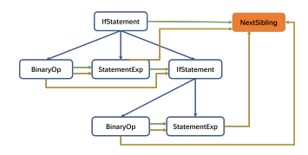

Graph Construction :
Child-Edge : the original edges in ASTs plus the new edges obtained because of node splitting and augmentation.
Next-Sibling-Edge : connect the sibling nodes in ASTs from left to right
Next-Use-Edge : connect a variable node to the next node of the same variable with depth-first search.
Next-Token-Edge : connect the leaf nodes from left to right so that the corresponding tokens comply with the order that they appear in the source code
In addition to the above edges, we borrow the idea from the control flow graph and propose to introduce the Control-Edges into ASTs, so that the data and control flow of a program could be better captured.
Example of control-edges :
An if-else statement

Slide 27
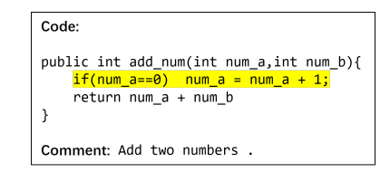
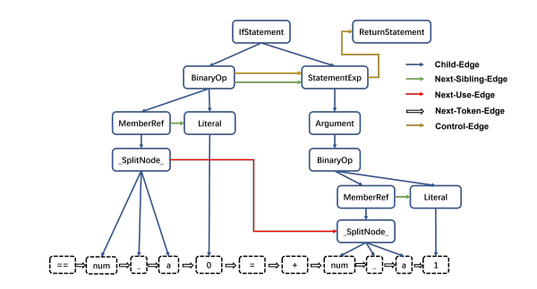
Constructed AST with all the different edges.

Slide 28
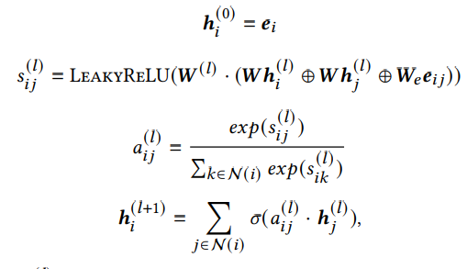


Encoding with Graph Attention Neural Networks (GAT) :
Recurrently update the state of a node by aggregating its own state and the states of all its neighbours at each step, using the attention mechanism.
Denote by and , the embedding of node i and the embedding of the edge from node j to node i.
The node states are updated as follows :
Where denotes the state of node i at layer l. W and are the shared weight matrices for nodes and edges, is the weight matrix at layer l. denotes the attention weight of contribution from node j to i at layer l. N(i) denotes the neighbour nodes of node i.
The node states of the last GAT layer compose the output matrix of the g-encoder.

Slide 29

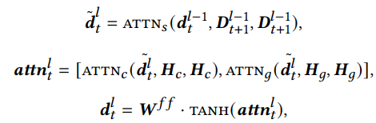
The Fusion Decoder
In the encoder-decoder attention sublayer, we apply the attentions of the decoder’s hidden states to the output of each encoder, respectively, and then concatenate the output states of the two attention modules for further process.
Given the output embeddings of the c-encoder and of the g-encoder and let the hidden states of decoder’s layer l before step t be denoted by , we can formulate the decoding process at step t of layer l as :
are the parameters of the feed forward sublayer and is the encoding at position t of layer l.

Slide 30


Dual-Copy Mechanism
To better improve the ability of capturing keywords and solving the out-of-vocabulary problem, we propose a dual-copy mechanism to copy tokens from the two encoders.
For the final hidden vector at position t output by the decoder, we first compute the probability vector for choosing generation or copying as follows:
Then we compute the sampling distribution for generation and copying. For sampling from the vocabulary, the probability distribution is directly transformed from as :
For copying, we can naturally use the last layer’s attention weights of to all the encodings produced by each encoder, respectively, as the copy distribution, which can be formulated as : These are the probability distributions for copying from the input source code tokens and the leaf nodes.
The Attention scores on RHS denote the attention weights of to all the encodings of the c-encoder and g-encoder, respectively, in the last decoder layer.

Slide 31



Finally, the probability of producing a token in the summary at position 𝑡 is calculated as the joint probability:
The Objective Function : Used negative log-likelihood. Given a source code snippet and target summary the objective function can be formulated as :
𝑁 is the number of data points in the training data. 𝑇 is the length of the target summary.

Slide 32
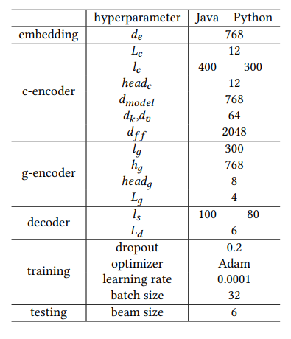
Hyperparameter settings for GypSum

Slide 33
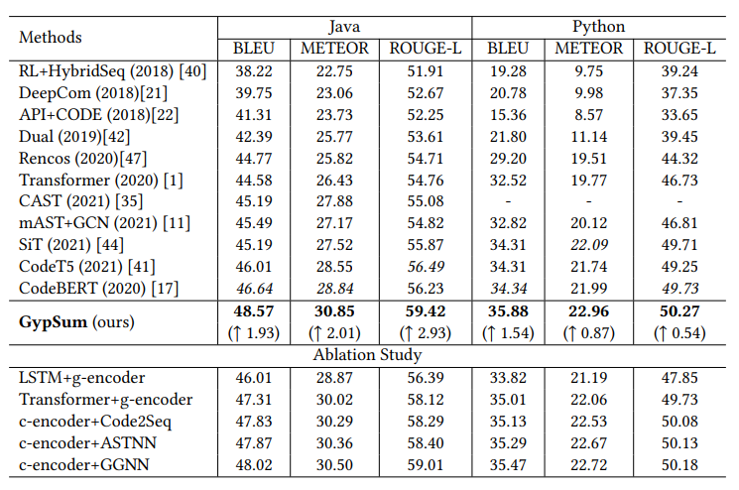
Results
Dataset :
87,136 Java code snippets
87, 226 Python code snippets
The score of each metric on a testing set is computed as the average score of all the generated summaries. For all the metrics, a higher score indicates better performance.

Slide 34
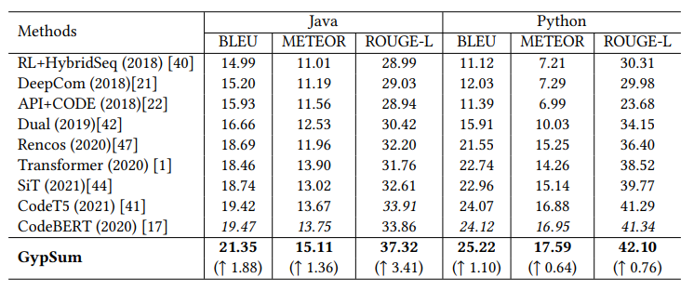
Results on cleaned testing sets
A large fraction of code snippets in the testing set are also presented in the training set, for both datasets. For the Java dataset, about 39% of the code snippets in the testing set are actually contained in the training set and for the Python dataset, the fraction is about 21%. To better evaluate the generalization ability of the models, we remove those duplicated snippets and report the additional results on the cleaned testing sets.

Slide 35
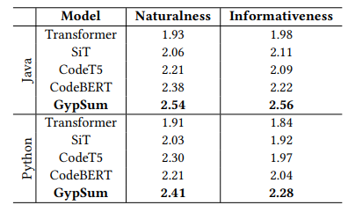
User Study
We conduct a user study on the quality of the summaries generated by the five best models. The evaluated metrics are naturalness and informativeness. Each summary is rated on the two metrics on a scale of 1 to 3, where a higher score means better quality.

Slide 36
UniXcoder: Unified Cross-Modal Pre-training for Code Representation

Slide 37
Introduction
Generally, user-written code comments provide crucial semantic information about source code like “Sort a given list” and AST contains rich syntax information like types of statements and nested relationship among them.
UniXcoder is pre-trained using three types of language modeling tasks :
masked language modeling
unidirectional language modeling
denoising objective
Introduced two pre-training tasks to learn a embedding that can represent semantics of a code fragment :
multi-modal contrastive learning - leverages AST to enhance semantics of code fragment embeddings.
cross-modal generation - utilizes code comment to align embeddings among programming languages

Slide 38
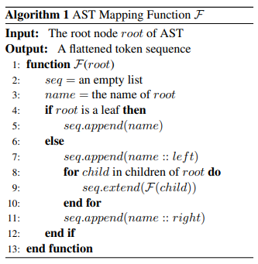
Input Representation
UniXcoder leverages multi-modal data (i.e. code comment and AST) to pre-train code representation.
In order to encode AST in parallel with code comments, we propose a one-to one mapping function F.
Specially, given a root node root of AST, the algorithm recursively applies the same function F to its children and then add its name with two special suffixes (i.e. left and right, respectively) on both sides.
Finally, given a source code C, we take its comment and the flattened AST token sequence as input, where is the root of the AST of the code. For input format, we concatenate them with a prefix as an input sequence.

Slide 39
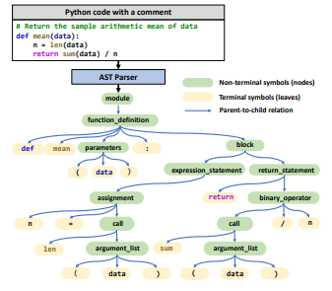
A particular transformation should be a one-to-one mapping function. Otherwise, the mapping may confuse a tree with another structure.
Taking “parameters → (data)” as an example, the mapping function F transforms the subtree to “ <parameters,left> ( data ) <parameters,right>”.

Slide 40
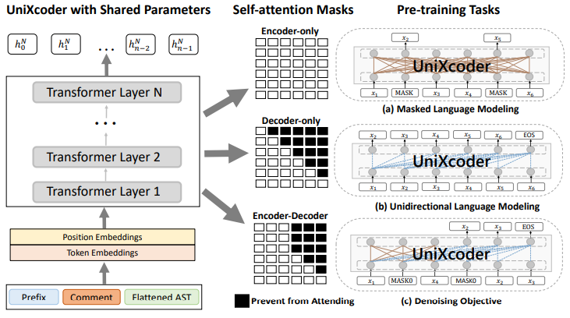
Model Architecture

Slide 41
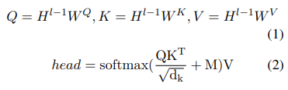
The model applies N transformer layers over code comment and flattened AST with a prefix to produce hidden states where the prefix p indicates the behavior of the model.
Each transformer layer contains an architecturally identical transformer that uses a multi-headed self-attention operation followed by a feed forward layer over the output of the previous layer. For the l-th transformer layer, the output of the multi-headed self-attention is computed via: where previous layer’s output is linearly mapped to a triplet of queries, keys and values respectively. is the dimension of a head, and is a mask matrix to control the context a token can attend to when computing its contextual representation. If the i-th token is allowed to attend to the j-th token, then is set to 0 otherwise −∞.

Slide 42

Pre-Training Tasks
Masked Language Modelling :
For encoder-only mode
Sample 15% of the tokens from the input sequence, and then replace 80% (10%) of them with a [MASK] (random) token and leave another 10% of them unchanged.
The task is to predict original tokens of masked tokens based on their bidirectional contextual tokens.
Model can leverage semantic information from comment and syntax information from AST to infer masked code tokens, which encourages the model to learn code representations from different knowledge resources.
Objective is calculated as:
is the masked input sequence

Slide 43

Unidirectional Language Modelling :
Pre-train decoder-only mode for supporting auto-regressive tasks like code completion.
The task predicts the next token one by one conditioned on previous tokens and itself which can be done using a triangular matrix for attention mask.

Slide 44

Denoising Objective :
For encoder-decoder models
The task randomly masks spans with arbitrary lengths and then generates these masked spans in encoder-decoder mode
First split the input sequence into chunks and then randomly mask a span of from 1 to 2l-1 tokens for each chunk, where n is the length of the input, r is corruption rate and l is the average length of masked spans.
Set corruption rate as 15% and the average length as 5, respectively. The concatenation of all masked spans with special tokens in front of the k-th span will be used as the output.

Slide 45
Code Fragment Representation Learning :
Propose to utilize multi-modal data to learn semantic embedding of a code fragment .
First use UniXcoder to encode a mapped AST sequence and then apply a mean pooling layer over the hidden states of the source input to obtain semantic embedding .
In order to learn the semantic embedding, we propose two pre-training tasks:
Multi-modal contrastive learning (MCL)
Cross-modal generation (CMG)

Slide 46

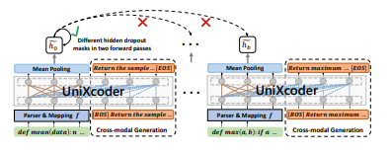
multi-modal contrastive learning (MCL) : forward the same input using different hidden dropout mask as a positive example and use other representations in the same batch as negative examples.
The loss is calculated as : where b is batch size, τ is a temperature hyperparameter, and cos(·, ·) is the cosine similarity between two vectors.

Slide 47

For cross-modal generation, we ask the model to generate its comment . Since the generation of the comment is conditioned on the code, it will force the model to fuse semantic information from the comment into the hidden states of the code.
The loss is calculated as :
In order to learn the semantic embedding of natural language, we randomly exchange the source input and the target input with a probability of 50%.
Considering that explicitly adding AST in downstream tasks will introduce extra costs like parsing time and increasing input length we implicitly learn knowledge from AST by pre-training and only keep leaves of AST (i.e. source code) in the fine-tuning phase. This gap can be alleviated by randomly drop all non-terminal symbols of AST with a probability of 50% in the pre-training phase.
X is the flattened AST token sequence.

Slide 48
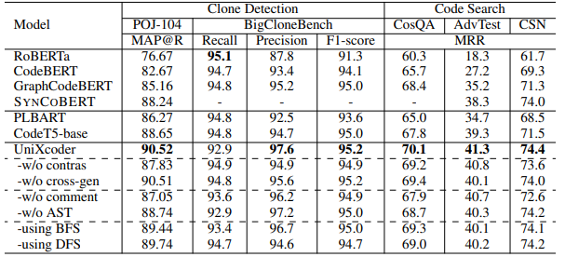
Tasks and Results
Understanding Tasks :
Clone Detection : measure the similarity between two code fragments.
Datasets : POJ-104 and BigCloneBench
Evaluation metrics : F1-score and Mean Average Precision (MAP)
Code Search : to find the most relevant code from a collection of candidates given a natural language query.
Datasets : CSN, AdvTest and CosQA
Evaluation metrics : Mean Reciprocal Rank (MRR)

Slide 49
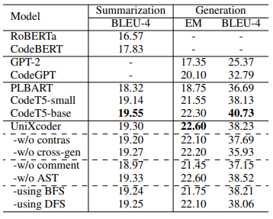
Generation Tasks :
Code Summarization : to generate an NL summary of a code snippet
Dataset : CodeXGLUE
Evaluation metric : smoothed BLEU-4
Code Generation :
Dataset : CONCODE
Evaluation metrics : exact match (EM) and BLEU-4

Slide 50
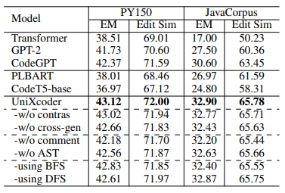
Code Completion : completion of a whole-line of code
Dataset : PY150 and Github Java Corpus datasets in CodeXGLUE
Evaluation metrics : exact match accuracy and Levenshtein edit similarity

Slide 51
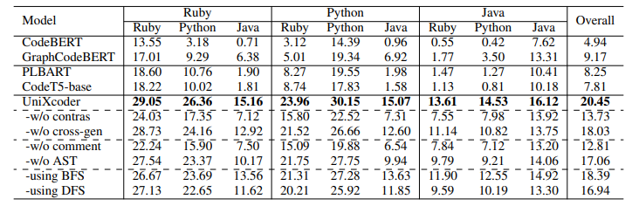
Zero-shot Code-to-Code Search : Given a source code as the query, the task aims to retrieve codes with the same semantics from a collection of candidates in zero-shot setting.
The task can help users translate from one PL to another by retrieving source codes with the same semantics
collected 11,744/15,594/23,530 functions from the CodeNet corpus in Ruby/Python/Java PL. Each function solves one of 4,053 problems.
Used average MAP score as the evaluation metric

Slide 52
Model Analysis
Taking zero-shot code-code search task as an example, after removing contrastive learning, the performance drops from 20.45% to 13.73%.
AST does not bring improvements on generation tasks, which may require a better way to incorporate AST for generation tasks.
As we can see, after replacing our mapping function by BFS or DFS algorithms, the performance of UniXcoder drops on both understanding and generation tasks, which demonstrates the effectiveness of our mapping function.

Slide 53
What Do They Capture? - A Structural Analysis of Pre-Trained Language Models for Source Code

Slide 54
Contributions
Analyze the self-attention weights and align the weights with the syntax structure. Given a code snippet, our assumption is that if two tokens are close to each other in the AST, i.e., have a neighbourhood relationship, the attention weights assigned to them should be high.
Design a structural probing approach to investigate whether the syntax structure is embedded in the linear-transformed contextual word embedding of pre-trained code models.
Investigate whether the pretrained language models for source code provide the ability of inducing the syntax tree without training.

Slide 55
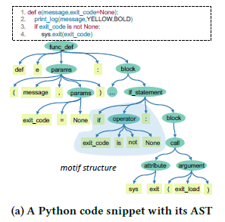
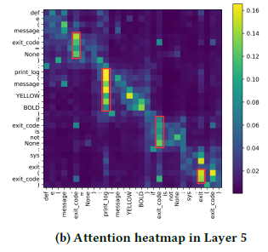
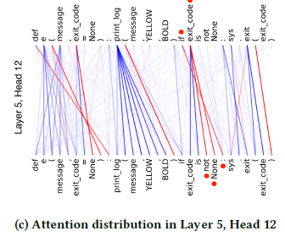

Slide 56
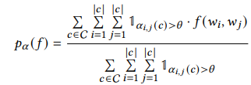
Attention Analysis
Let denote the code token sequence of code snippet𝑐, with length 𝑛. On the 𝑙-th layer of Transformer, we use to denote the sequence of contextual representation of each code token.
Intuitively, attention defines the closeness of each pair of code tokens.
We consider the syntactical relations such that the attention weight is high between two AST tokens sharing the same parent node.
We define an indicator function that returns 1 if and are in a syntactic relation ( have the same parent node in the AST ), and 0 otherwise.
We define the attention weight between and as , and if the tokens are very close, the attention weight should be larger than a threshold .
Therefore, the proportion of high-attention token pairs aggregated over a dataset C can be formulated as follows:

Slide 57
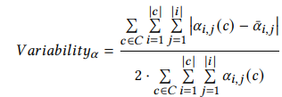
We hypothesize that those heads that are attending to the position, i.e., those heads that focus on the previous or next code token, would not align well with the syntax structure of code, since they do not consider the content of the code token.
To distinguish whether the heads are attending to content or position of the code token, we further investigate the attention variability, which measures how attention varies over different inputs.
The high variability would suggest a content-dependent head, while low variability would indicate a content-independent head.

Slide 58
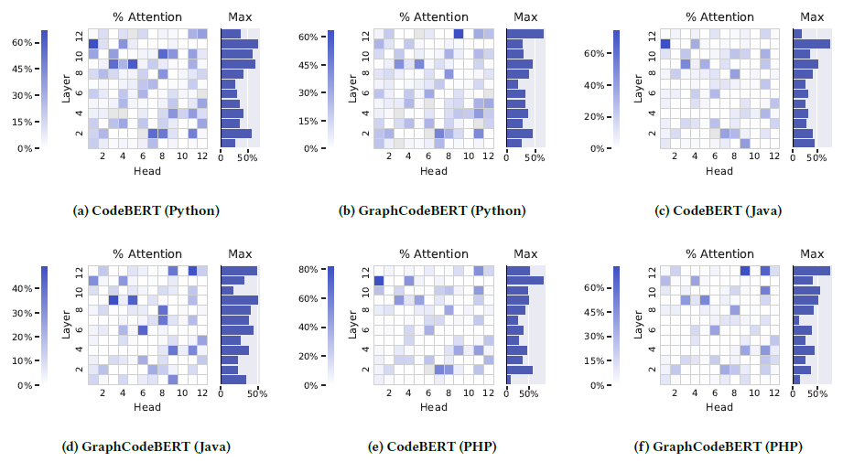
Results for Attention Analysis
Set the attention threshold 𝜃 as 0.3. Only include the results of attention heads where at least 100 high-confidence attention scores are available in our analysis.
We can observe that the most aligned heads are located in the deeper layers and the concentration is as high as 67.25% These high scores indicate that attention aligns strongly with the motif structure in AST, especially in the deeper layers. This is because the heads in deeper layers have stronger capabilities in capturing longer distances.

Slide 59
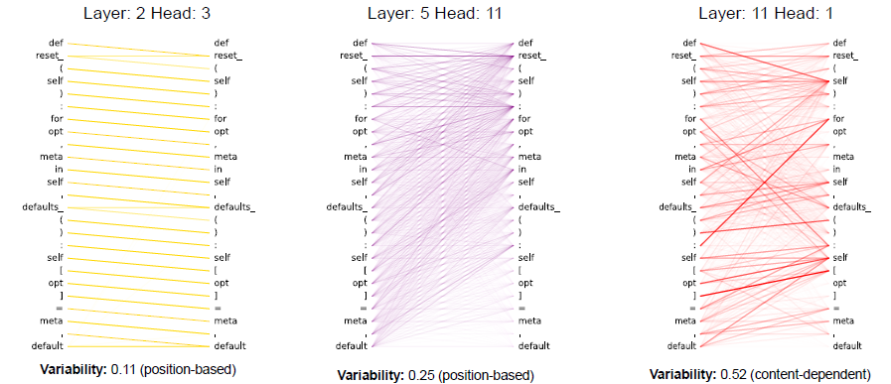
Although there is a strong alignment between the attention and the syntax structure of code, it is still necessary to distinguish whether the attention is based on the position or content of code token.
We find that the learned attention weights are strongly aligned with the motif structure in an AST. Additionally, each attention across different heads and layers put different focus on the position and content of the tokens of source code.
There are heads which do not consider the context of text. It could suggest that if we remove these heads, it will not affect the final results and we can reduce the number of parameters of the pre-trained models.
Based on the variability defined, we can see that the attention in Layer 5, Head 11, is evenly dispersed, with the variability of 0.25. Moreover, in Layer 2, Head 3, it is apparent to see that the attention is focusing on the next token position. Layer 11, Head 1 is a content-dependent head.

Slide 60
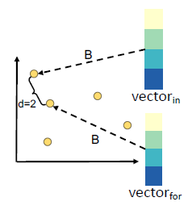

Structural Probing on Word Embedding
To investigate whether a pre-trained model embeds the syntactical structure in its contextual word embedding.
Tree structure is embedded if the transformed space has the property that the Euclidean distance between two words’ vectors corresponds to the number of edges between the words in the syntax tree.
Learn the mapping function B in a supervised way.
Given a code sequence as the input, and each model layer generates word vectors . We compute the square of distance between the two word vectors and in high-dimensional hidden space as follows: where 𝑖 and 𝑗 are indices of the words in the code sequence.

Slide 61

The parameters of the structural probe we use are exactly the matrix 𝐵 (linear mapping), which is trained to reconstruct the tree distance between all word pairs ) in the code sequence 𝑇 in the training set of source code.
Loss function for parameter training is defined as: where |𝑐| is the length of code sequence c, denotes the distance between code tokens in AST, and denotes the distance between the embedding vectors of code tokens, for code sequence 𝑐.
The goal of this supervised training is to propagate the error backwards and update the parameters of the linear mapping matrix 𝐵.

Slide 62
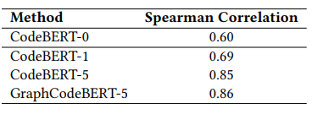
Results for Structural Probing on Word Embedding
We measure the correlation between the predicted distance using word embedding and the distance in the AST. Used Spearman correlation.
Probe the contextual representations in each layer of Transformer, and denote the investigated pre-trained code models as CodeBERT-𝐾 and GraphCodeBERT-𝐾, where 𝐾 indexes the layer of Transformer in corresponding model.
To serve as a comparison against the pre-trained code models, we also design a baseline model – CodeBERT-0, which denotes the simple word embedding before being fed into the Transformer layers.
Average Spearman correlation of probing in Python.

Slide 63
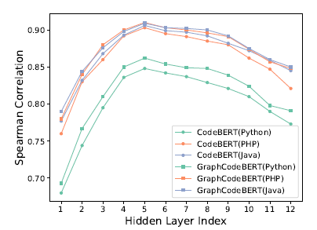
CodeBERT-0 without Transformer layers achieves inferior performance than that with multiple layers of Transformer. This confirms our assumption that Transformer has the ability of capturing the syntax information of source code.
GraphCodeBERT performs better than CodeBERT, indicting that it is helpful to explicitly incorporate the syntax structure into model pre-training.
We can observe that the capability of capturing syntax structure differs across different layers of Transformer. The best performance is obtained in the 5th layer

Slide 64
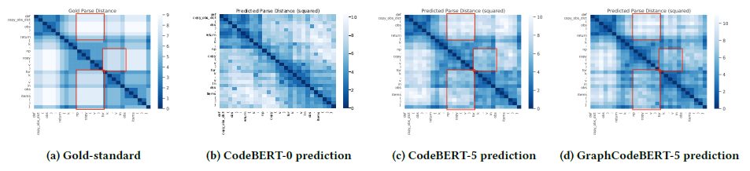
We can see that Figures c and d look more similar to the gold-standard one (Figure a) than to Figure b. In these figures, some matching parts are marked in red. The result confirms that CodeBERT-5 and GraphCodeBERT-5 (with multiple layers of Transformer) perform better than CodeBERT-0 (without passing through the Transformer layers).

Slide 65

Syntax Tree Induction
The key insight of our approach is that if the distance between two tokens is close (e.g., with a similar attention distribution, or with a similar representation), they are expected to be close in the syntax tree, i.e., sharing the same parent.
If the induced tree derived from the pre-training model is similar to the gold standard syntax tree, we can reasonably infer that the syntactic structures have been preserved during the model pre-training.
Formally, given a code sequence , we compute d = , where corresponds to the syntactic distance between tokens and . Each is defined as follows: where 𝑓 (·, ·) and 𝑔(·) denote the function of distance measurement and code representation learning, respectively.

Slide 66

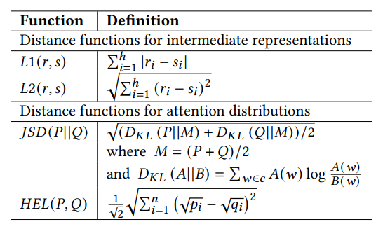
Let and denote the functions to generate the intermediate representation and self-attention in 𝑙-th layer and 𝑘-th head.
we can use 𝐿1 and 𝐿2 to calculate the similarity between two intermediate representation vectors. We can use Jensen-Shannon divergence and Hellinger distance to calculate the similarity between two attention distributions.

Slide 67
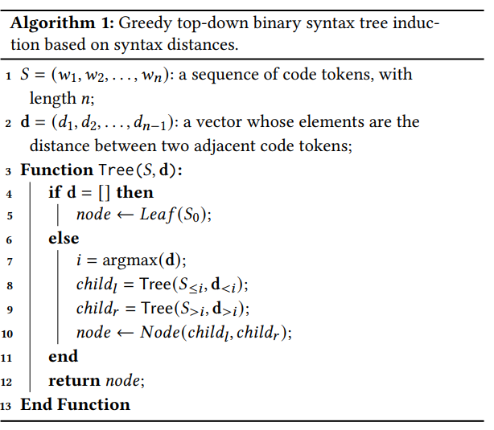
Once the distance vector d is computed, we can easily convert it to the target syntax tree through a simple greedy top-down inference algorithm based on recursive partitioning of the input.

Slide 68

The AST of source code tends to be right-skewed. We have influenced the induced tree such that they are moderately right-skewed following the nature of gold-standard ASTs.
We propose to inject the inductive deviation into the framework by simply modifying the value of the syntactic distance. We introduce the right-skewness bias to influence the spanning tree to make it right-biased appropriately.
New distances are obtained by adding a linear bias term as follows :

Slide 69
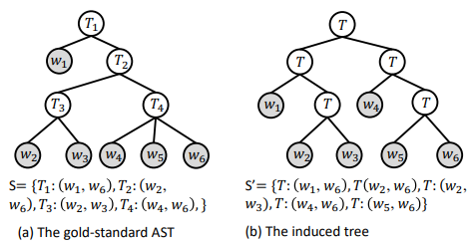



Similarity between the two trees : first transform the tree structure into a collection of intermediate nodes, where each intermediate node is composed of two leaf nodes. Then we measure the similarity between the two collections.
Given the two sets, we use F1 score to measure their similarity. The F1 score is the the harmonic mean of precision and recall, as follows:
Let 𝑆 denote the set of gold-standard tree, and 𝑆 ′ denote the set of predicted tree, we can calculate the precision and recall by precision =
recall =

Slide 70
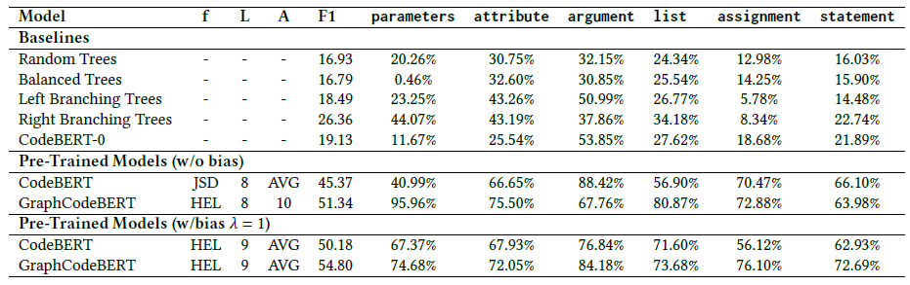
Results for Syntax Tree Induction
For comparison, we introduce four traditional greedy top-down tree induction baselines for comparison, e.g., random, balanced, left-branching, and right-branching binary trees. Take the random-based approach as an example, we recursively partition the code snippet based on a randomly selected position.
We also derive another baseline, CodeBERT-0, which is based on the word embedding before being fed into Transformer layers.

Slide 71
We can observe that the right-branching tree induction approach achieves the best performance among all the baselines, confirming our assumption that the AST tends to be right-skewed.
Pre-trained code models significantly outperform other baselines, even without bias injection.
These results show that the Transformer-based pre-training models are more capable of capturing the syntax structure of code to a certain extent through pre-training on a large-scale code corpus.
We can observe that injecting bias can increase the performance of syntax tree induction up to 5%. This improvement indirectly shows that the current pre-trained code models do not capture well the property of the right-skewness of AST. However, in certain cases, injecting bias can reduce performance. This can be due to the fact that although the AST shows a right-skewness trend as whole, several subtrees are not right-skewed.
We can find that the JSD and HEL distance functions that are performed over attention distributions perform better than those over contextual word representations. It shows that parsing trees from attention information is more effective than extracting from the contextual representation of pre-trained code models.

Slide 72
Modeling Hierarchical Syntax Structure with Triplet Position for Source
Code Summarization

Slide 73
Introduction
To model the hierarchical syntax structure of code using triplet position. The triplet position records the depth, width position of its parent, and width position among its siblings for each node.
To utilize the triplet position in AST, this paper proposes CODESCRIBE, an encoder-decoder based neural network.
Initialize the embedding of each AST node by incorporating the triplet positional embeddings, and then feed them into an improved GNN, i.e., GraphSAGE to represent the syntax of code.

Slide 74
Also account for the sequential information of code by using a Transformer encoder.
Decoding process is performed over the learned structural features of AST and sequential features of code tokens with two multi-head attention modules.
To generate summaries with higher quality, we further design a pointer-generator network based on multi-head attention which allows the summary tokens to be generated from the vocabulary or copied from the input source code tokens and ASTs.

Slide 75
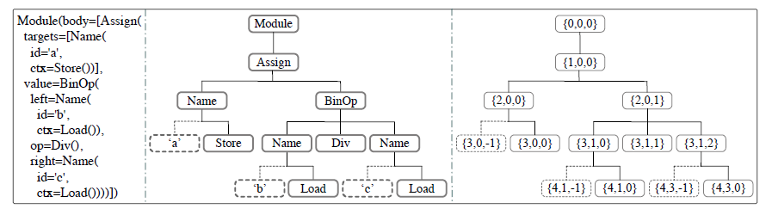
Triplet Position
we divide the nodes into two categories: (1) function node that controls the structure of AST and function realization, e.g., Module and Assign and (2) attribute node that provides the value or name of its parent function node, which is always visualized as leaf node, such as ‘a’ and ‘b’ in dotted boxes.

Slide 76
Due to the strict construction rules of AST, positions are crucial for AST nodes. . However, GNNs are insensitive to the positions of neighbouring nodes when encoding such tree structures.
We specify triplet positions for AST nodes to retain accurate structural information in AST learning.
The triplet position of a node includes:
the depth of the node in the AST
the width position of its parent node in the layer
the node’s width position among its siblings
The width position of a function node is a non-negative integer starting from 0, while the width position of an attribute node is a negative integer counting from -1.
With such triplet indices specified, all nodes can be marked with unique positions in a given AST.

Slide 77
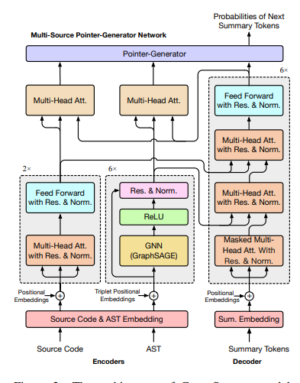
Model Architecture
Code snippet with tokens
sequential positions
and its AST with nodes
and triplet positions
CODESCRIBE predicts the next summary token
based on the existing tokens
with the sequential positions
where </s> is a special starting tag for summary input.
The architecture of CODESCRIBE model is mainly composed of four modules: source code encoder, AST encoder, summary decoder and multi-source pointer-generator network (MPG) for output.

Slide 78

Initial Embeddings
For AST, we take each triplet position in as an individual tuple, and directly map it into a positional embedding vector . The embedded triplet positional information is then added to the node embeddings for initializing the AST representation.
In the above equations, CNEmb denotes the shared embedding operation for source code tokens and AST nodes; SEmb means the token embedding operation for summary text; CPEmb, NPEmb, and SPEmb are the corresponding positional embedding operations.

Slide 79

Source Code Encoder
The code encoder is composed of two identical layers. And each layer consists of two sub-layers: multi-head attention mechanism and fully connected position-wise feed-forward network (FFN).
In addition, residual connection and layer normalization are performed in the two sub-layers for the sake of vanishing gradient problem in multi-layer processing and high offset of vectors in residual connection.
For the k-th layer, the process can be formulated as:
Where is the output vectors from the (k−1)-th layer

Slide 80

AST Encoder
GraphSAGE shows high efficiency and performance dealing with graphs, we introduce the idea of GraphSAGE and improve it by adding residual connection for AST encoding.
The encoding layer processes the AST by firstly aggregating the neighbors of the nodes with edge information and then updating the nodes with their aggregated neighborhood information.
For a node i and its neighbors in the k-th layer, the process can be formulated as follows: where means the vector representation of i-th node from the (k−1)-th layer; N(i) is the neighbors of the node i; denotes the j-th neighbor vector for node i are learnable weight matrices; Aggr represents aggregation function.

Slide 81

After updating the node information, the node vectors are put together into a ReLU activation for non-linear transformation:
With the increase of the number of layers, a node aggregates the neighborhood information from a deeper depth. In order to achieve strong capability of aggregation, the AST encoder is composed of six layers. in this formula denotes the output vectors of nodes from the (k−1)-th layer.

Slide 82

Summary Decoder
Six stacks of modified Transformer decoding blocks.
Given the existing summary tokens, the k-th decoding block firstly encodes them by masked multihead attention with residual connection and layer normalization, which is formalized as: where is the output vectors from the (k−1)-th layer.
Two multi-head attention modules to interact with the two encoders for summary decoding. One s performed over the AST features to get the first-stage decoded information, which will then be fed into the other over the learned source code for the second-stage decoding.
Then the decoded summary vectors are put into FFN for non-linear transformation
where and are the learned features of AST nodes and code tokens, respectively.

Slide 83

Multi-Source Pointer-Generator Network
To yield the final probability of the next summary token. It allows CODESCRIBE to generate summary tokens both from the summary vocabulary and from the AST and source code.
Taking the m-th output token as an example, to get the first probability distribution pv, a Linear sub-layer with Softmax is applied over the decoded summary token vector as follows: For a token w, if w is an out-of-vocabulary word to the summary vocabulary.
For distribution model applies an additional multi-head attention layer stacked on the last code encoding block and summary decoding block. It takes the decoded summary token vector as query and the encoded code information as key and value:

Slide 84


Through the function Mean and Softmax, the attention vectors of all heads are averaged as . For the token w, its probability : where means the e i-th token in the source code.
Similarly, we can get and corresponding to the AST. After that, the final probability of the token w is defined as a mixture of the three probabilities:

Slide 85
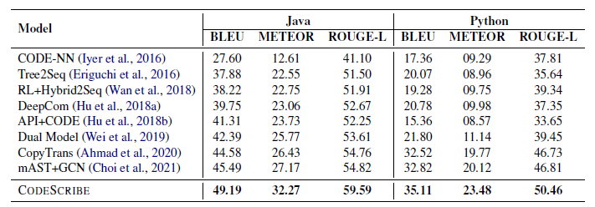
Results

Slide 86
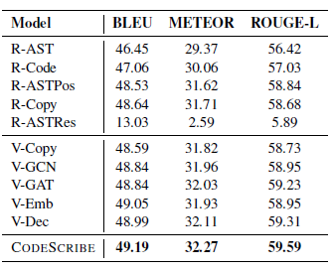
Ablation Study

Slide 87
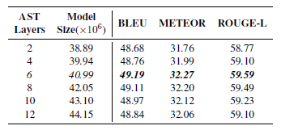


Study on Model Size

